Slide 1
The 11th STQM World Convention
STQM Asia 1 Bloc Convention in SIS
Fine view from the top of Sanden Forest
September 2018
No.274

Slide 2




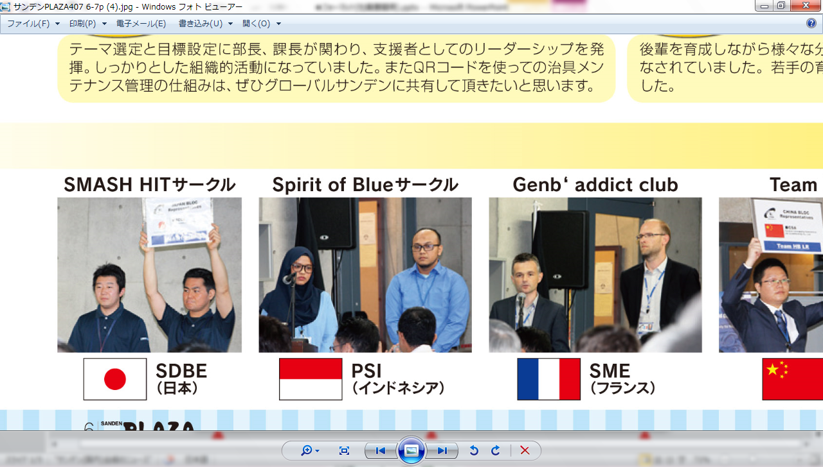
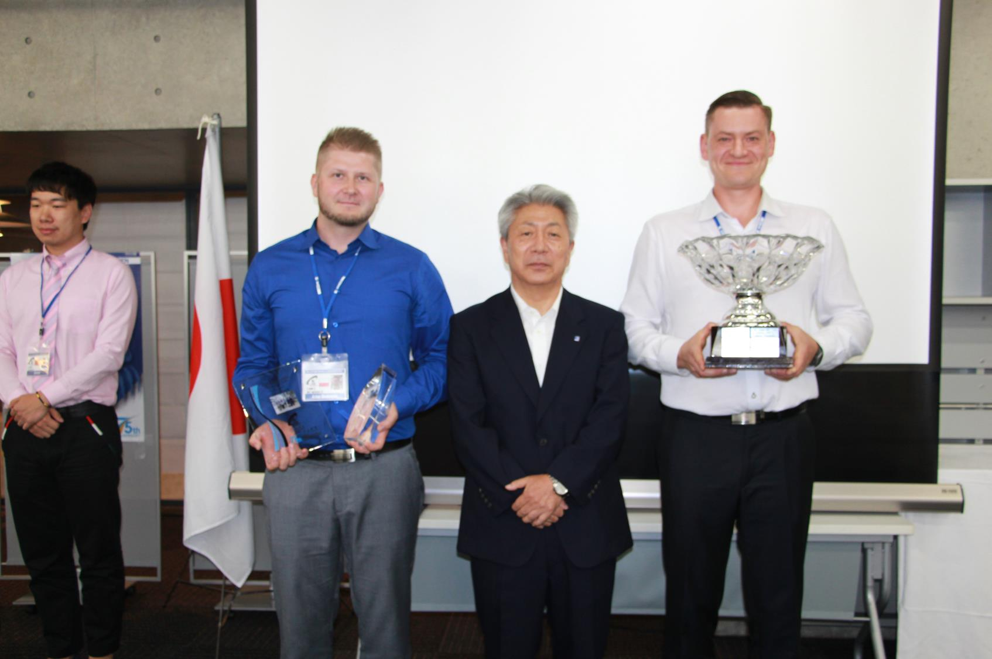
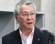
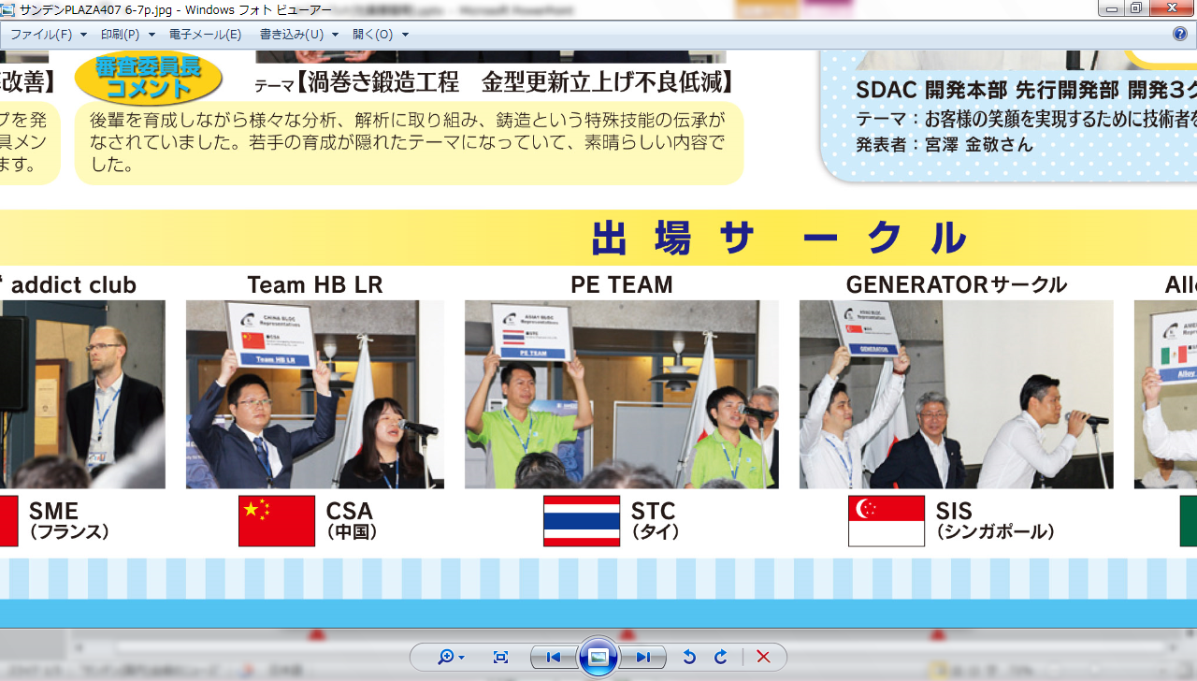




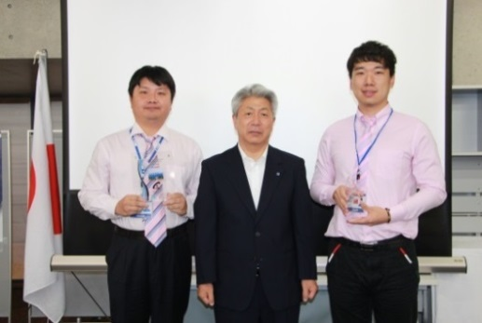
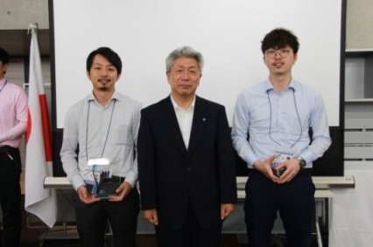
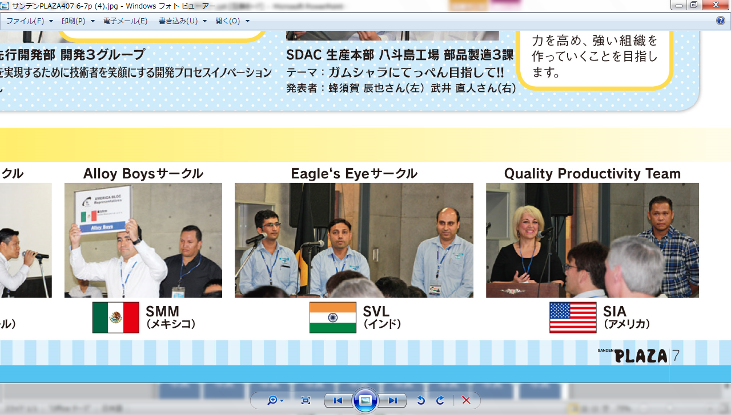
The 11th STQM World Convention -Aiming to realize Kaizen Activity for Next Growth-
Aug.1.2018
SDHD
Grand Champion 2018
MC Maniacs (SMP)
Presentation Circles
1st Prize
-Piston coating material usage reduction-
Comment of Judge chairman
They doing thoroughly detailed analysis and investigations to pursuit cause problem. And utilizing design of experiments method to establish secure approach and processes.
Mr.Artur Bednarek Mr.Bartłomiej Sielicki
Surmount(SSB)
Hot Forging(SDAC)
-PX 2#line shaft clearance
FTQ improvement-
-Reduction in scroll end dropping
defect occurring on set up new
tooling in the scroll forging
process-
2nd Prize
3rd Prize
Mr.Chen Qiyi Mr.Zhou Qi
Mr.Takuya Shimamura Mr.Yusuke Baba
They utilized QR code for maintenance of Jigs.
It is really interesting in and valuable to share for Globally.
It is one of ideal case to carry on technology and knowhow to next generation. So making the successor is hidden theme during the activity.

Slide 3

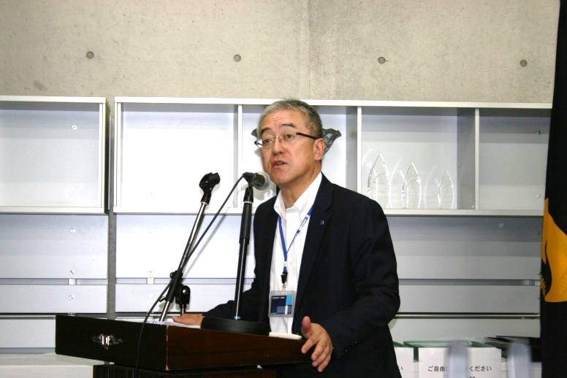
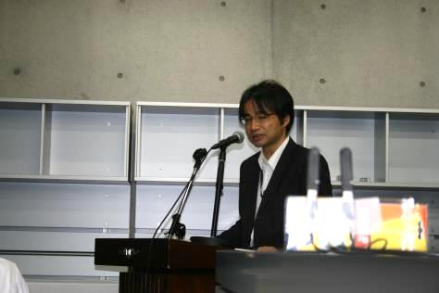
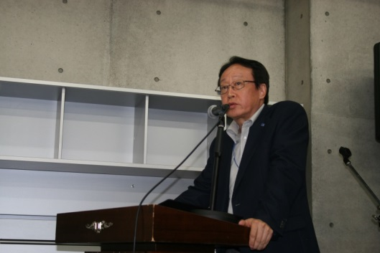
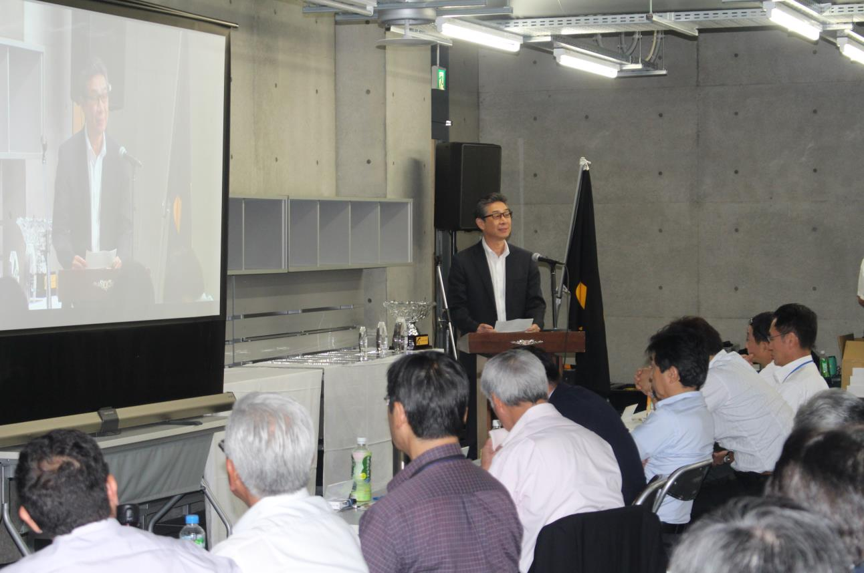
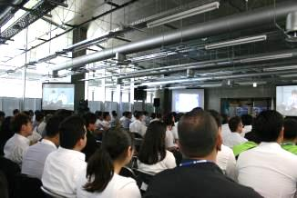
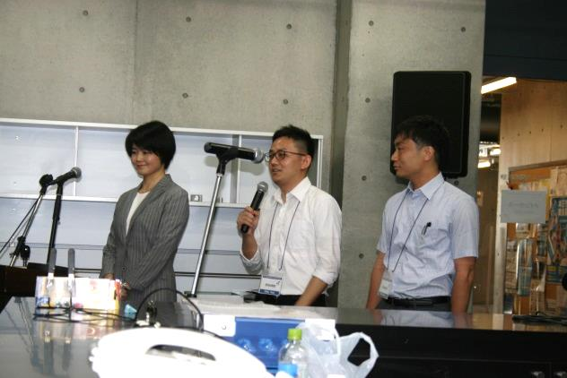
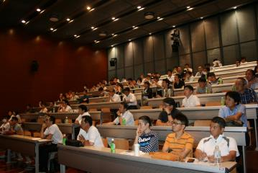
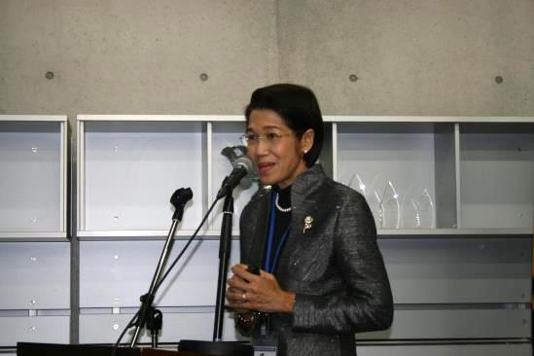
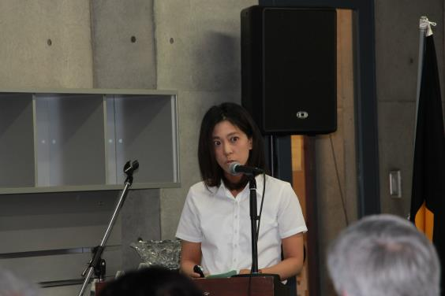
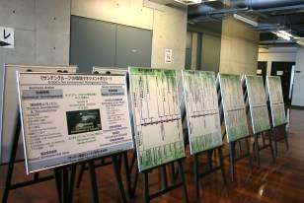
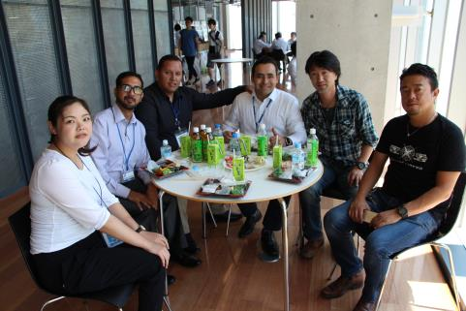
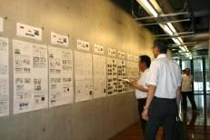
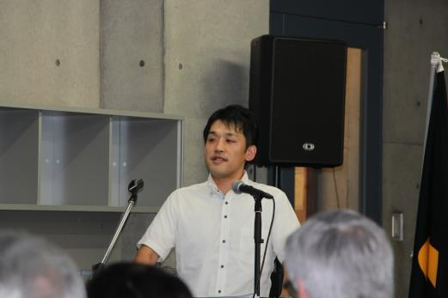
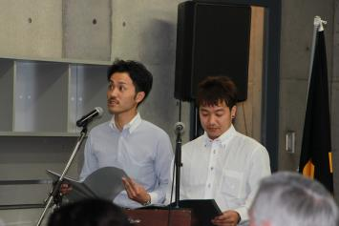
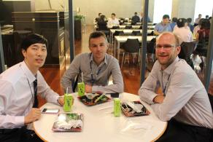
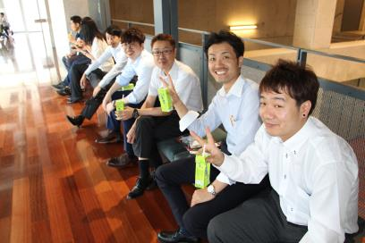
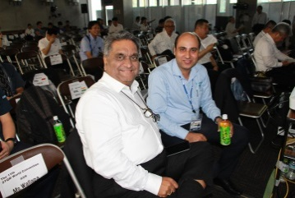
The 11th STQM World Convention -Aiming to realize Kaizen Activity for Next Growth-
Aug.1.2018
SDHD
Judge Chairman : Mr.Mitsunori Kodaka
(SDHD) Director & Senior Executive
Corporate Officer
Organizer In Japan: Mr.Akihiro Yamato
(SDHD) Executive Corporate Officer
The situation of the venue of the world convention
Welcome Speech
Waseda University
Mr. Tsutomu Kadomura
Opening and Closing Declaration
Head of STQM Office
Mr. Tadashi Yoshida
Guest Speech
Executive Director of JUSE
Mr. Norihiko Nakajima
Main Hall
I would like each of you to utilize the SGA from now on. I would like to ask each of you act thoroughly to accomplish our mid-term plan by utilize SGA globally
Let's continue STQM activity as the valuable quality improvement activities for our customers.
MC Members
Satellite Hall
～Best Practices –Customer First～
-STQM Experience@STC-
-Co-creation activity with
supplier (Σ127 Activity) -
We find that our key success
factors to promote STPM.
1.Top Management Direction
2.Employee’s Cooperation &
Contribution
3.STPM Knowledge
4.Continuity
5.Tools of QC and TPM
”Σ 127" means the gathering of the power of 127 suppliers.
In order to improve the quality of procured parts, we have been implementing in educating suppliers for 25 years.
Suppliers are aiming to present at the world convention as a representative circle of Japan bloc.
Presenter：Deputy Management Director of STC
Ms.Wallapa Sivadechathep
Presenter : (SDHD) R&D and Production Division,
MPS Management Office
Ms. Marina Yoshida
Various exhibits and panels
-Innovation in Development process-
-We are hell-bent on going for the top!! -
We introduced IT tools "i QUAVIS" for the purpose of improving the skills of engineers and supporting creative work.
To satisfy the customer, the technician must do more creative job with smile.
We devised "Sweating Map" as a tool to improve communication at the workplace. Along with the growth of the circle member's mind, it has evolved into "Treasure Map" to "Smile Map".
Through SGA we have built a strong team work.
Presenter : (SDAC) Development Group 3,
Advanced Development Department, R&D Division
Mr.Kanetaka Miyazawa
Presenter：(SDAC) Component Manufacturing 3
Department 1, Manufacturing Division
Mr. Tatsuya Hachisuka and Mr. Naoto Takei
Lunch time

Slide 4
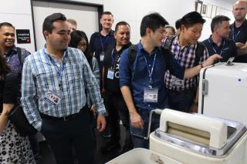
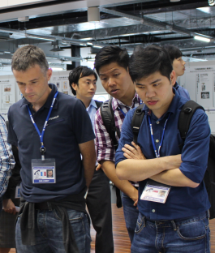
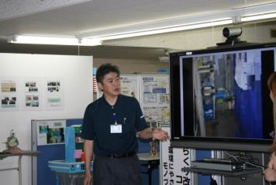
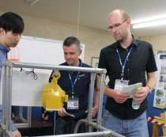
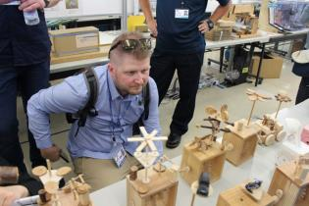

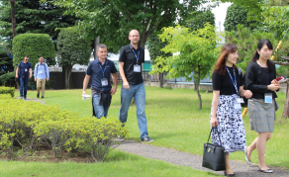
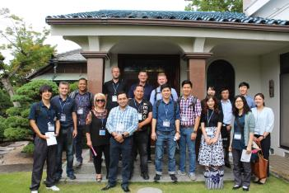
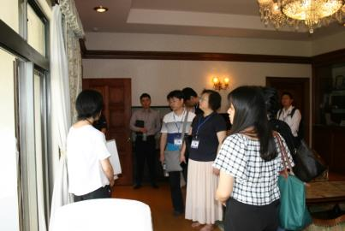
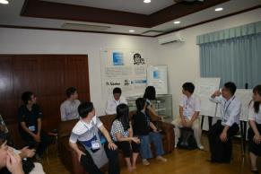
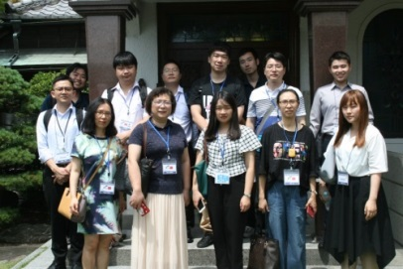
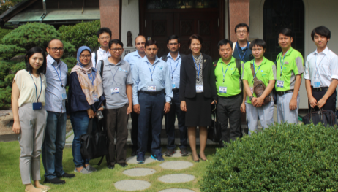
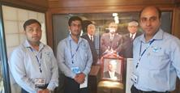
The 11th STQM World Convention -Aiming to realize Kaizen Activity for Next Growth-
Aug.1.2018
SDHD
Learn more "SANDEN"! ~ Sanden Road tour~
①R&D Expo @ SGCT (Products · Advanced technology)
②Exhibition of Karakuri (Originality and ingenuity)
Explainer about Karakuri Improvement.
Mr. Katsuhiko Saito
"Why was this Karakuri created?"
"How does this mechanism help?"
Everyone is interested in home appliances and old products that Sanden had once produced.
Commemorative photo with everyone!
③Sanden Global Center of History
(Founder's history)
This is the old Sanden logo.
Owl…They imagined to shine on the lights
to the dark with big bright eyes.
Do you know the origin of the
Sanden logo?
Everyone who listens to the episode of Founder’s mother.
Together with the three great founders of Sanden.

Slide 5
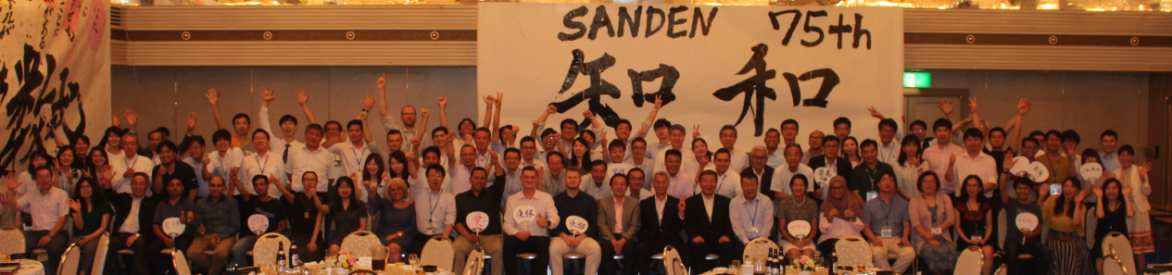
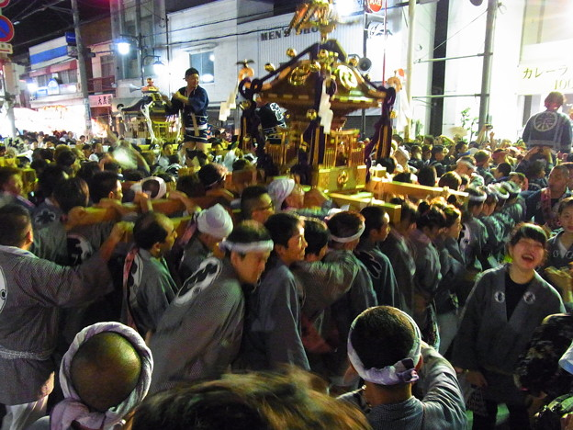
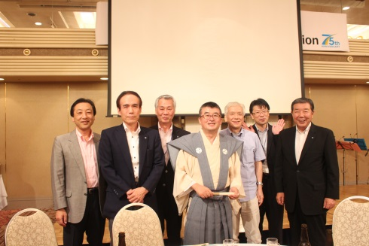
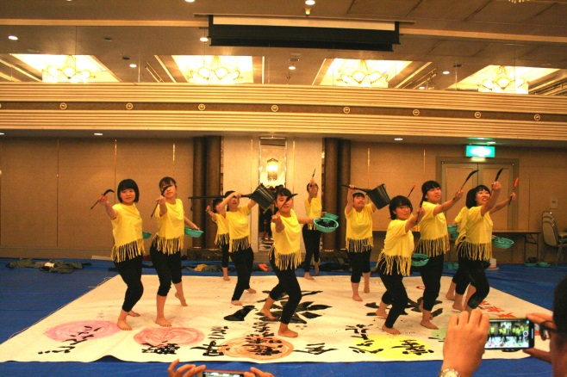
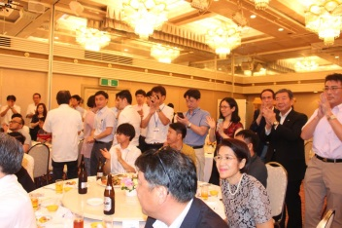
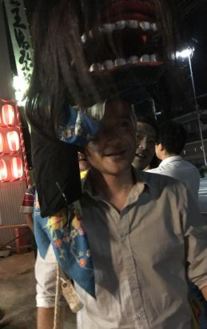
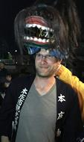
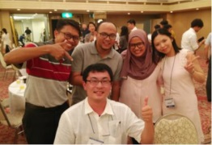
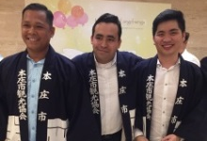
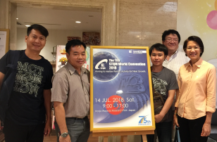
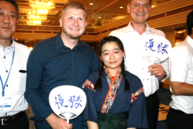
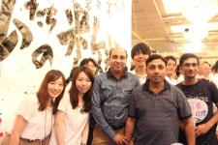
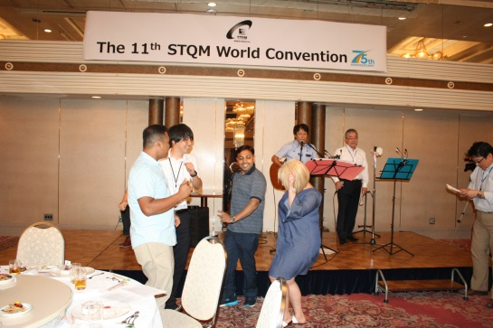
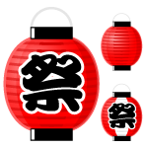



The 11th STQM World Convention -Aiming to realize Kaizen Activity for Next Growth-
Aug.1.2018
SDHD
Reception after World Convention
Honjo Gion Matsuri
(Japanese traditional festival)
Mayor Honjo Mr. Shinge Yoshida
Reception was held at Saitama Grand Hotel.
High school students showed Japanese calligraphy performances（Shodou）, participants challenged "Shodou" and enjoyed singing and dancing.
That night was the traditional Japanese festival - Honjo Gion Matsuri -.
Wearing Matsuri stile "Happi", everyone enjoyed the night in Japan.
In the legend of Japan, the participants of the festival will not get sick
for a year.

Slide 6






















The 11th STQM World Convention -Aiming to realize Kaizen Activity for Next Growth-
Aug.1.2018
SDHD
Global Team Work Build in Honjo
Another Victory
Winner France
in the FIFA World Cup 15th July 2018
Sightseeing inTokyo
Operation Staff in Japan
Next>>SVL(India)
The cooperation of many people supported this World Convention.

Slide 7







STQM Asia 1 Bloc Convention in SIS
Jul.24.2018
SIS
Singapore
SIS had the honour of hosting the STQM Asia 1 Bloc Convention on 24th July’18. A total of 9 teams presented their SGA activities. There were 2 teams from SIS (Singapore), 1 team from PSI (Indonesia), 1 team from ISI (Iran), 2 teams from SVL (India), 1 team from SVP (India) and 2 teams from PVL (India).
SIS management Mr. Shigeharu Nakamura gave a welcome/opening speech, followed by Mr. Tadashi Yoshida, Head of STQM office emphasized the level and importance of SGA, in the respective SI fronts. There were 5 Juries representing 5 of the Sanden Group companies (SIS, ISI, PSI, SVL/SVP & PVL) respectively.
Champion team belonged to Precision from SVP, while 1st and 2nd runner-up went to Homa from ISI and Akagi from SIS respectively. Congratulations and well done to all the teams for their great effort and for providing valuable learning points to everyone.
Precision (SVP)
Homa (ISI)
Akagi (SIS)
Merlion Park
Elaine Lim
SIS

Slide 8



Fine view from the top of Sanden Forest
Aug.1.2018
SFC
In the morning
Look around the extensive Kanto Plain
Today we introduce the view of the Kanto Plain from the top of Sanden Forest.
The view is famous for its beautifulness by local, especially night one. You can also see Tokyo Sky Tree (one of the famous for highest buildings in Japan) and Mt. Fuji with the blue sky in the winter morning on sunny days.
Please come to Sanden Forest and enjoy this original landscape !
Sunset
At night
SFC Yoshii

